Slide 1

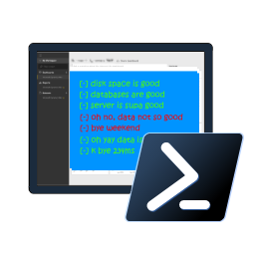


SQL Notebooks in Azure Data Studio for the DBA
Rob Sewell -@SQLDBAWithABeard

Slide 2
WHO AM !?

Slide 3

















Our sponsors
Platinum and event
Gold
Global
Silver
Bronze
Raffle

Slide 4
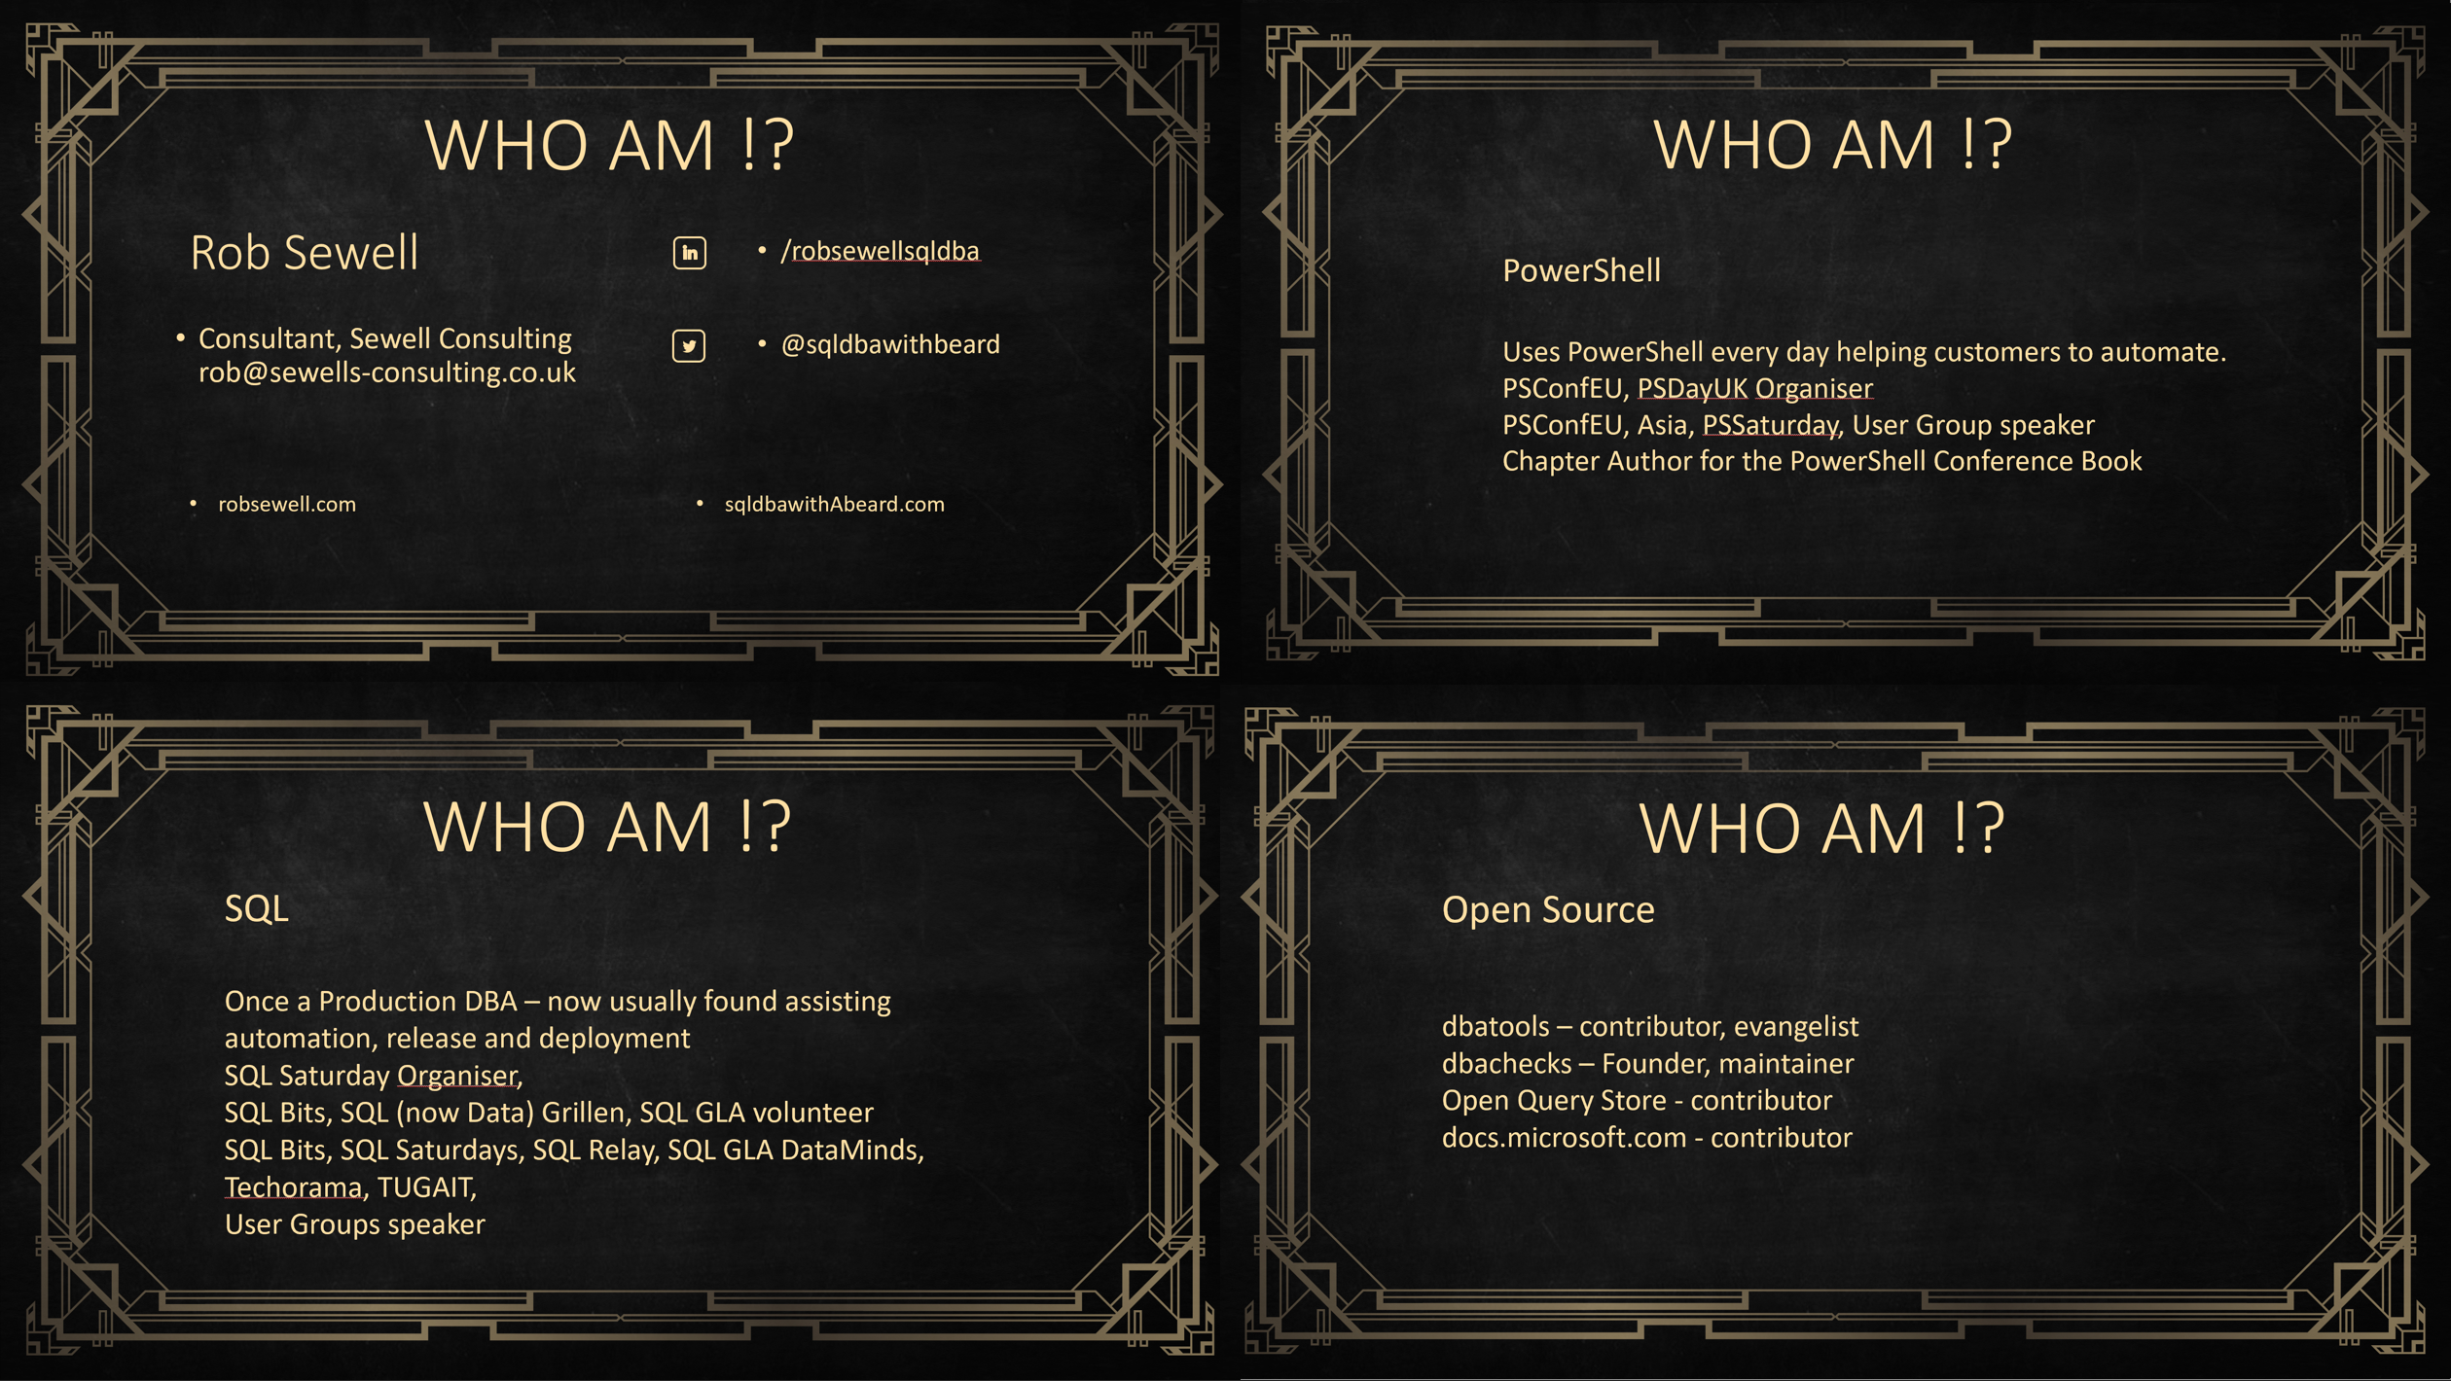
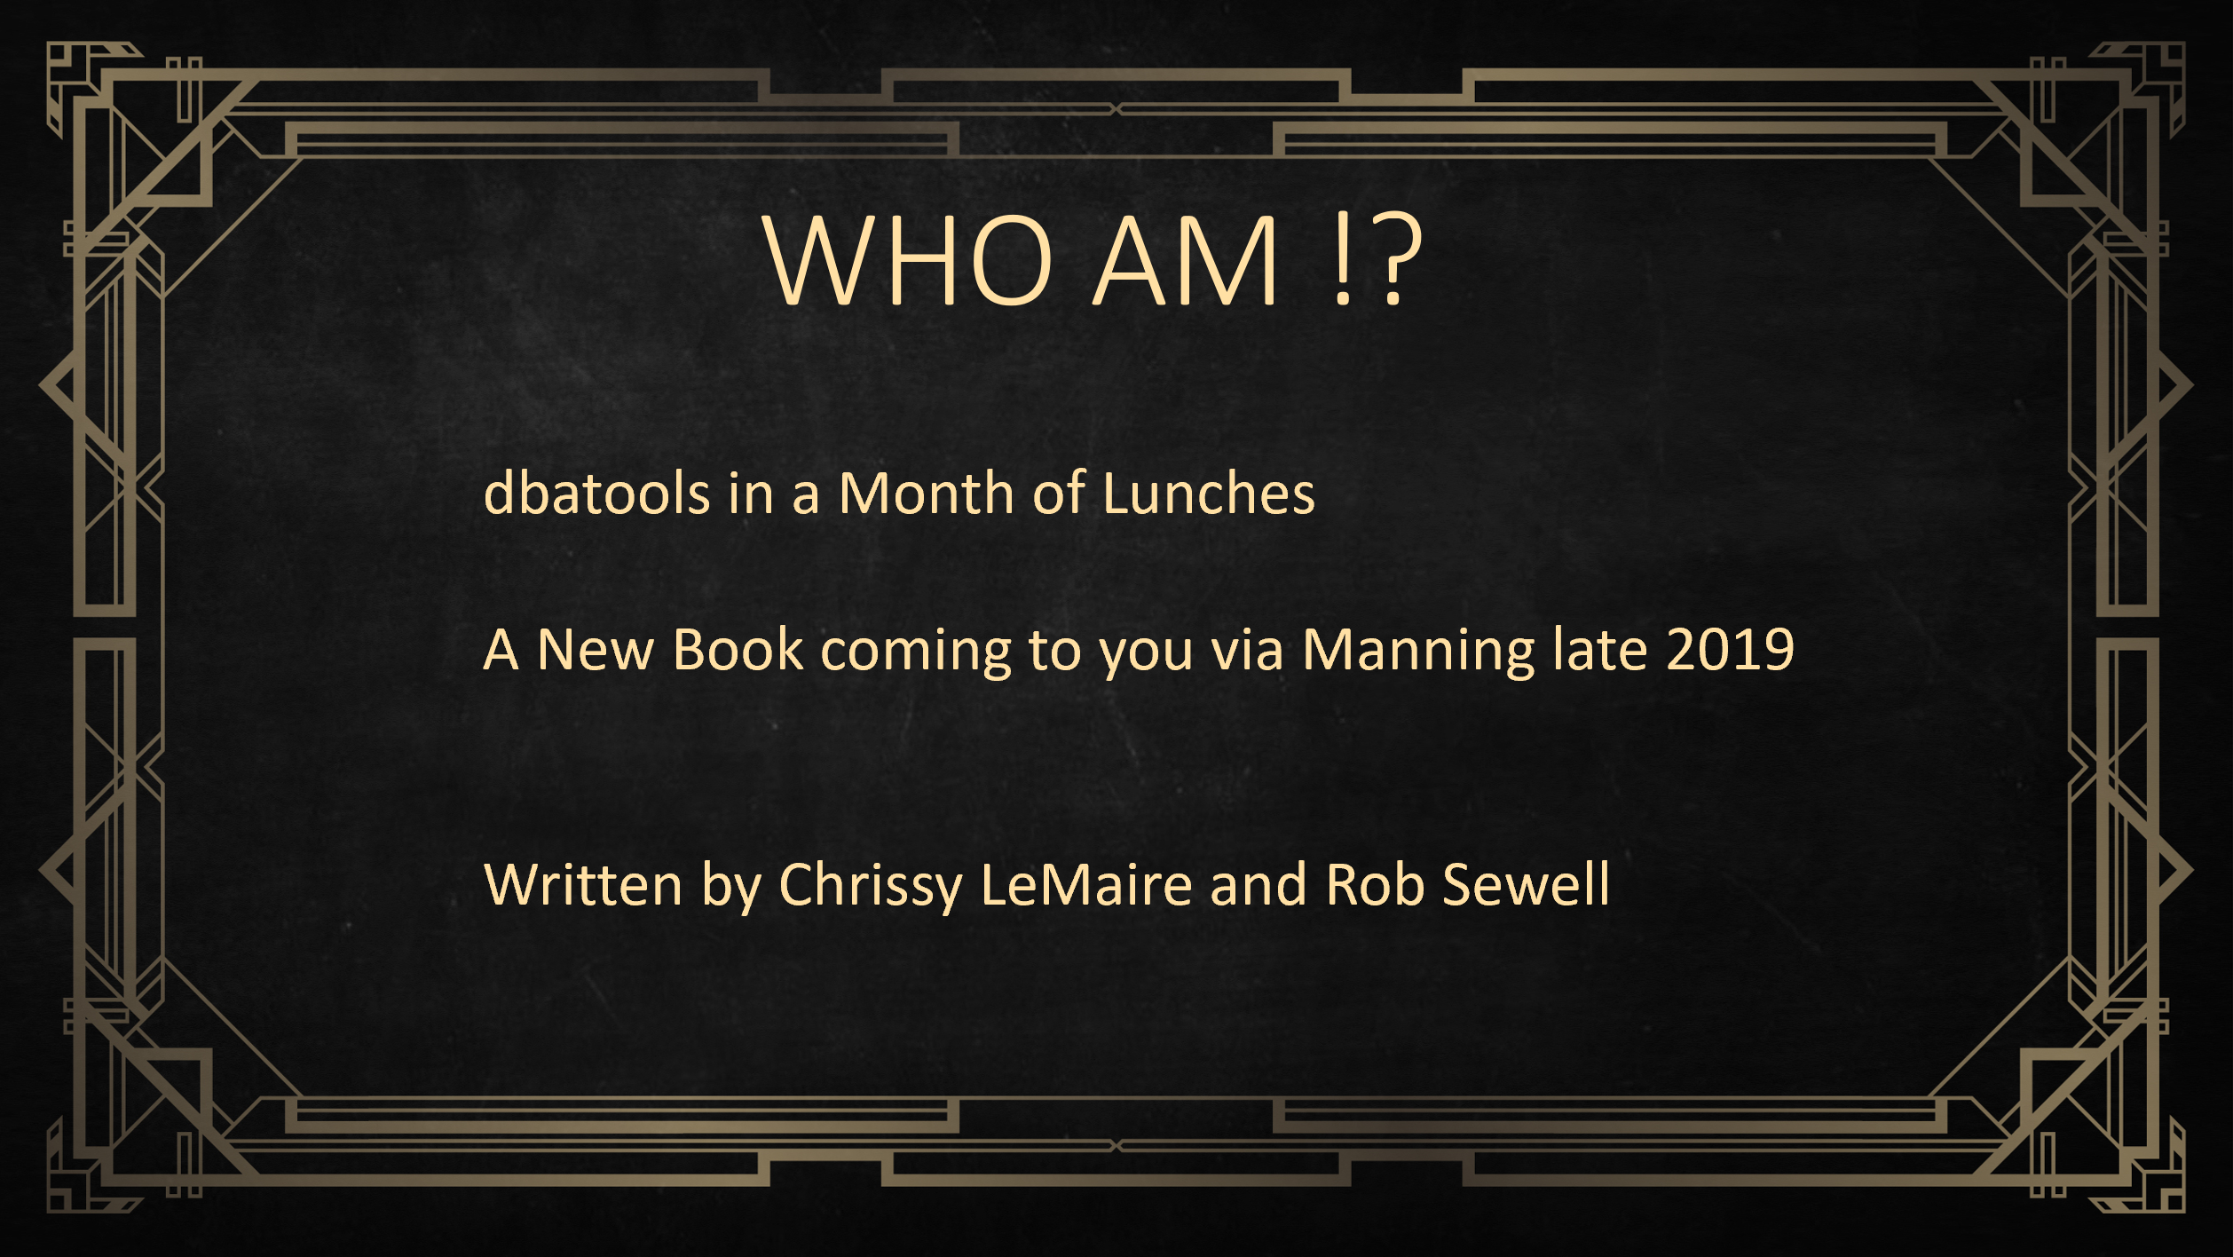

Slide 5
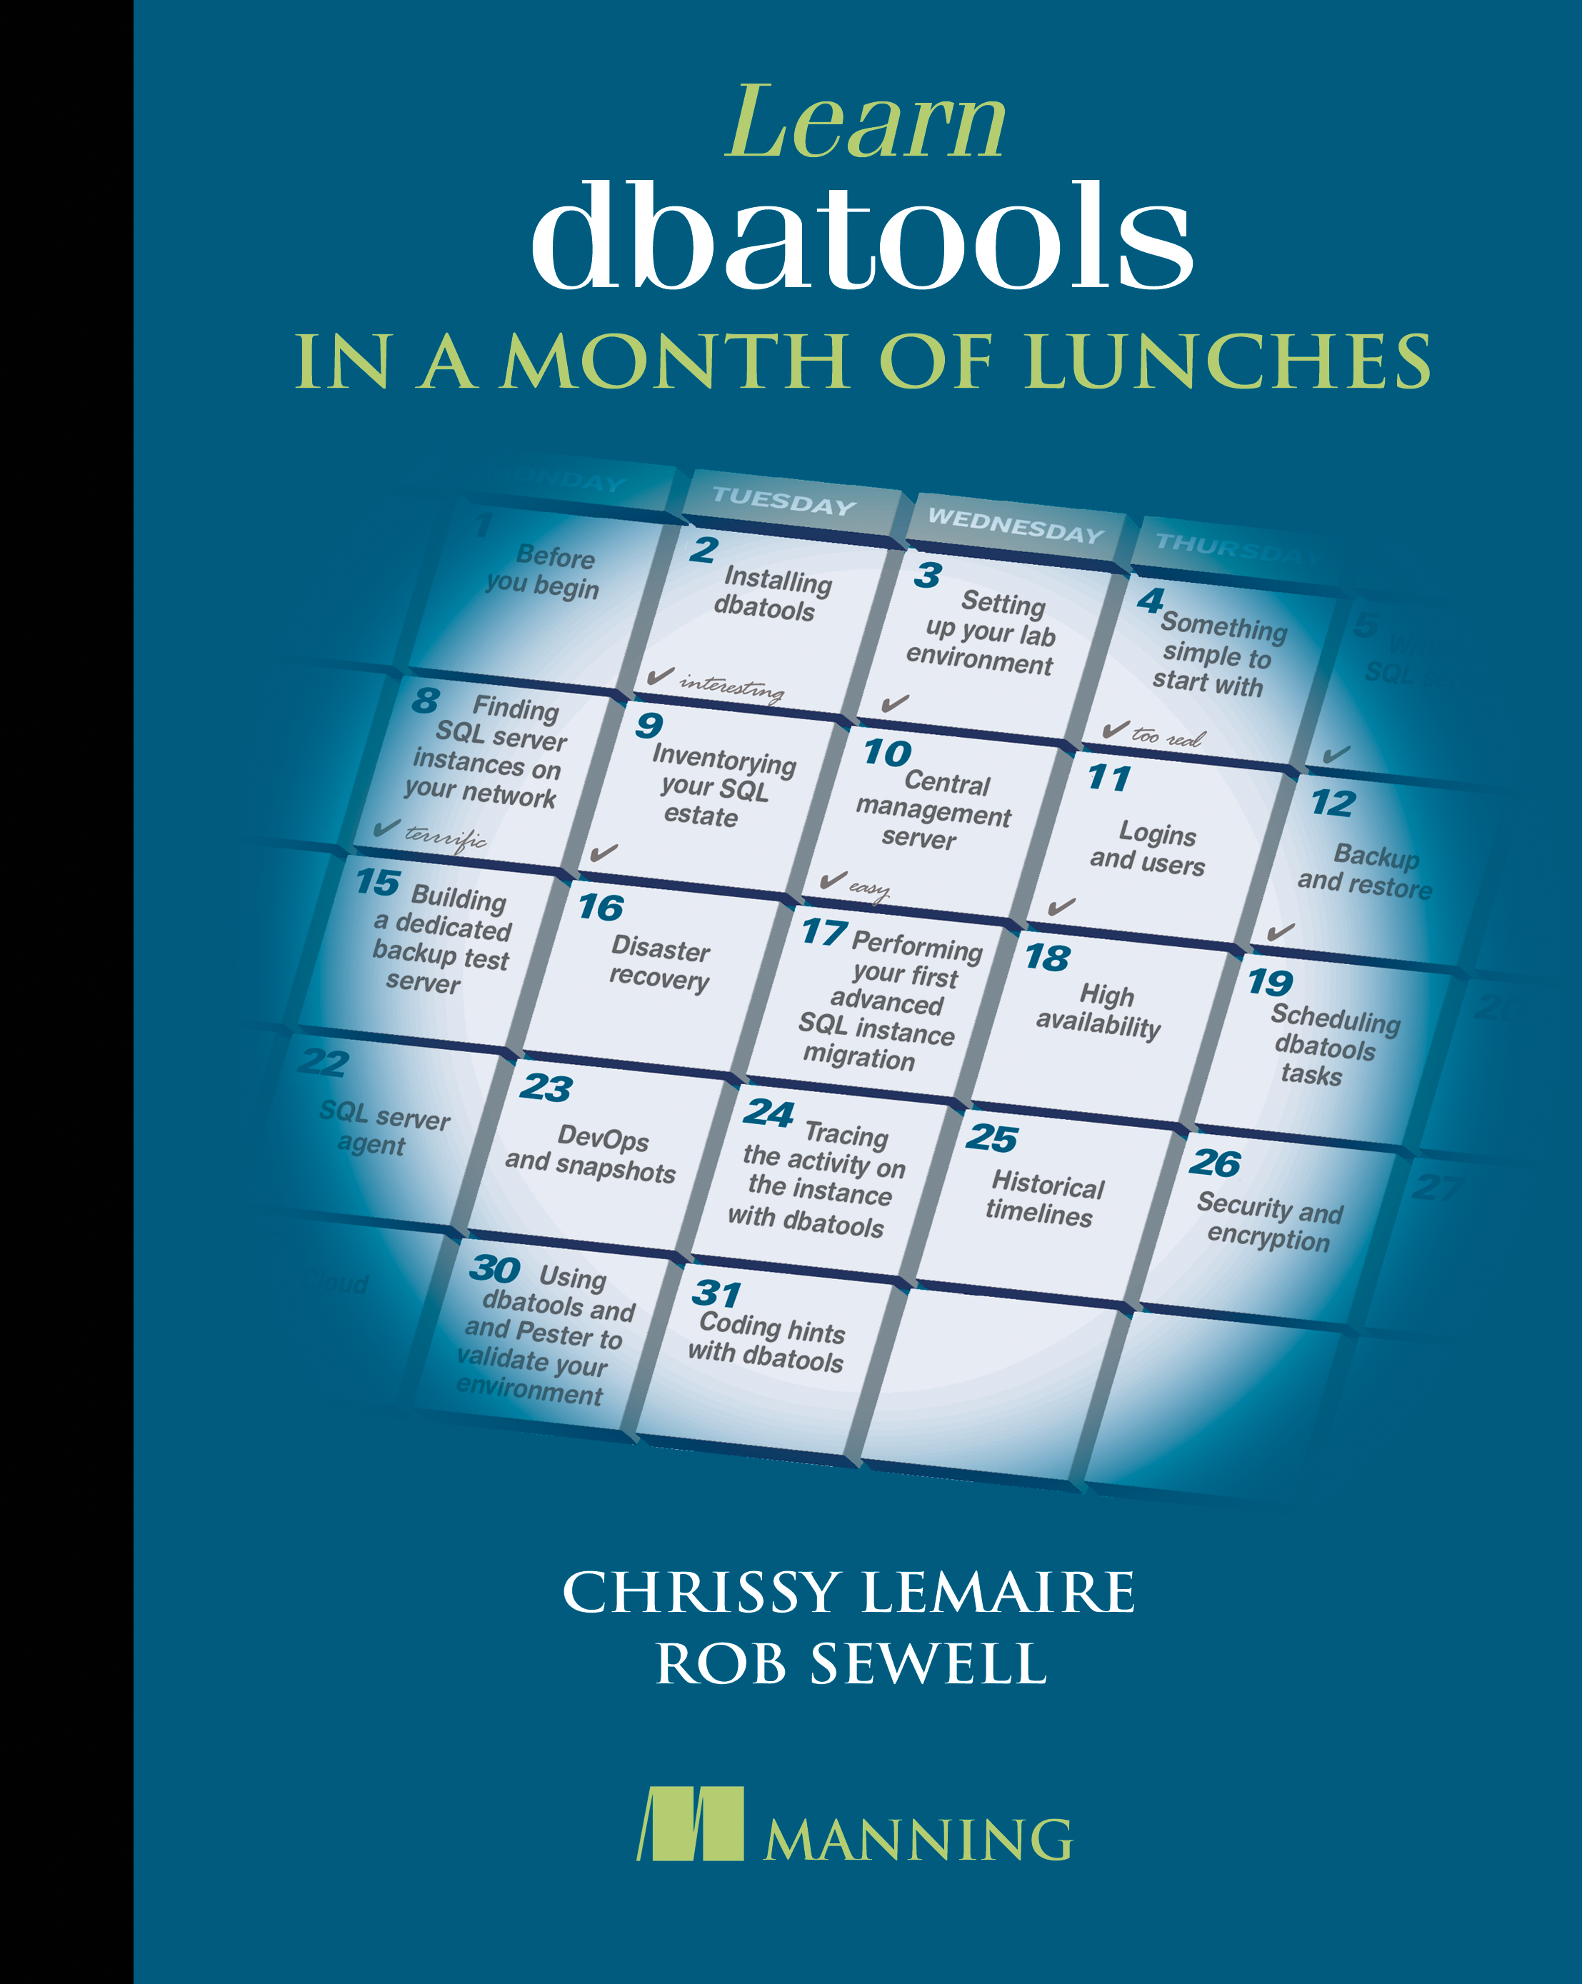
Here Now ! dbatools.io/book
The MEAP has opened for dbatools in a Month of Lunches
New book from Manning
Your Code for 50% off ctwsqlos19

Slide 6
Slides and Code
All my Presentations
github.com/SQLDBAWithABeard/Presentations

Slide 7

Buckle Up !! It‘s Demo time

